Slide 1
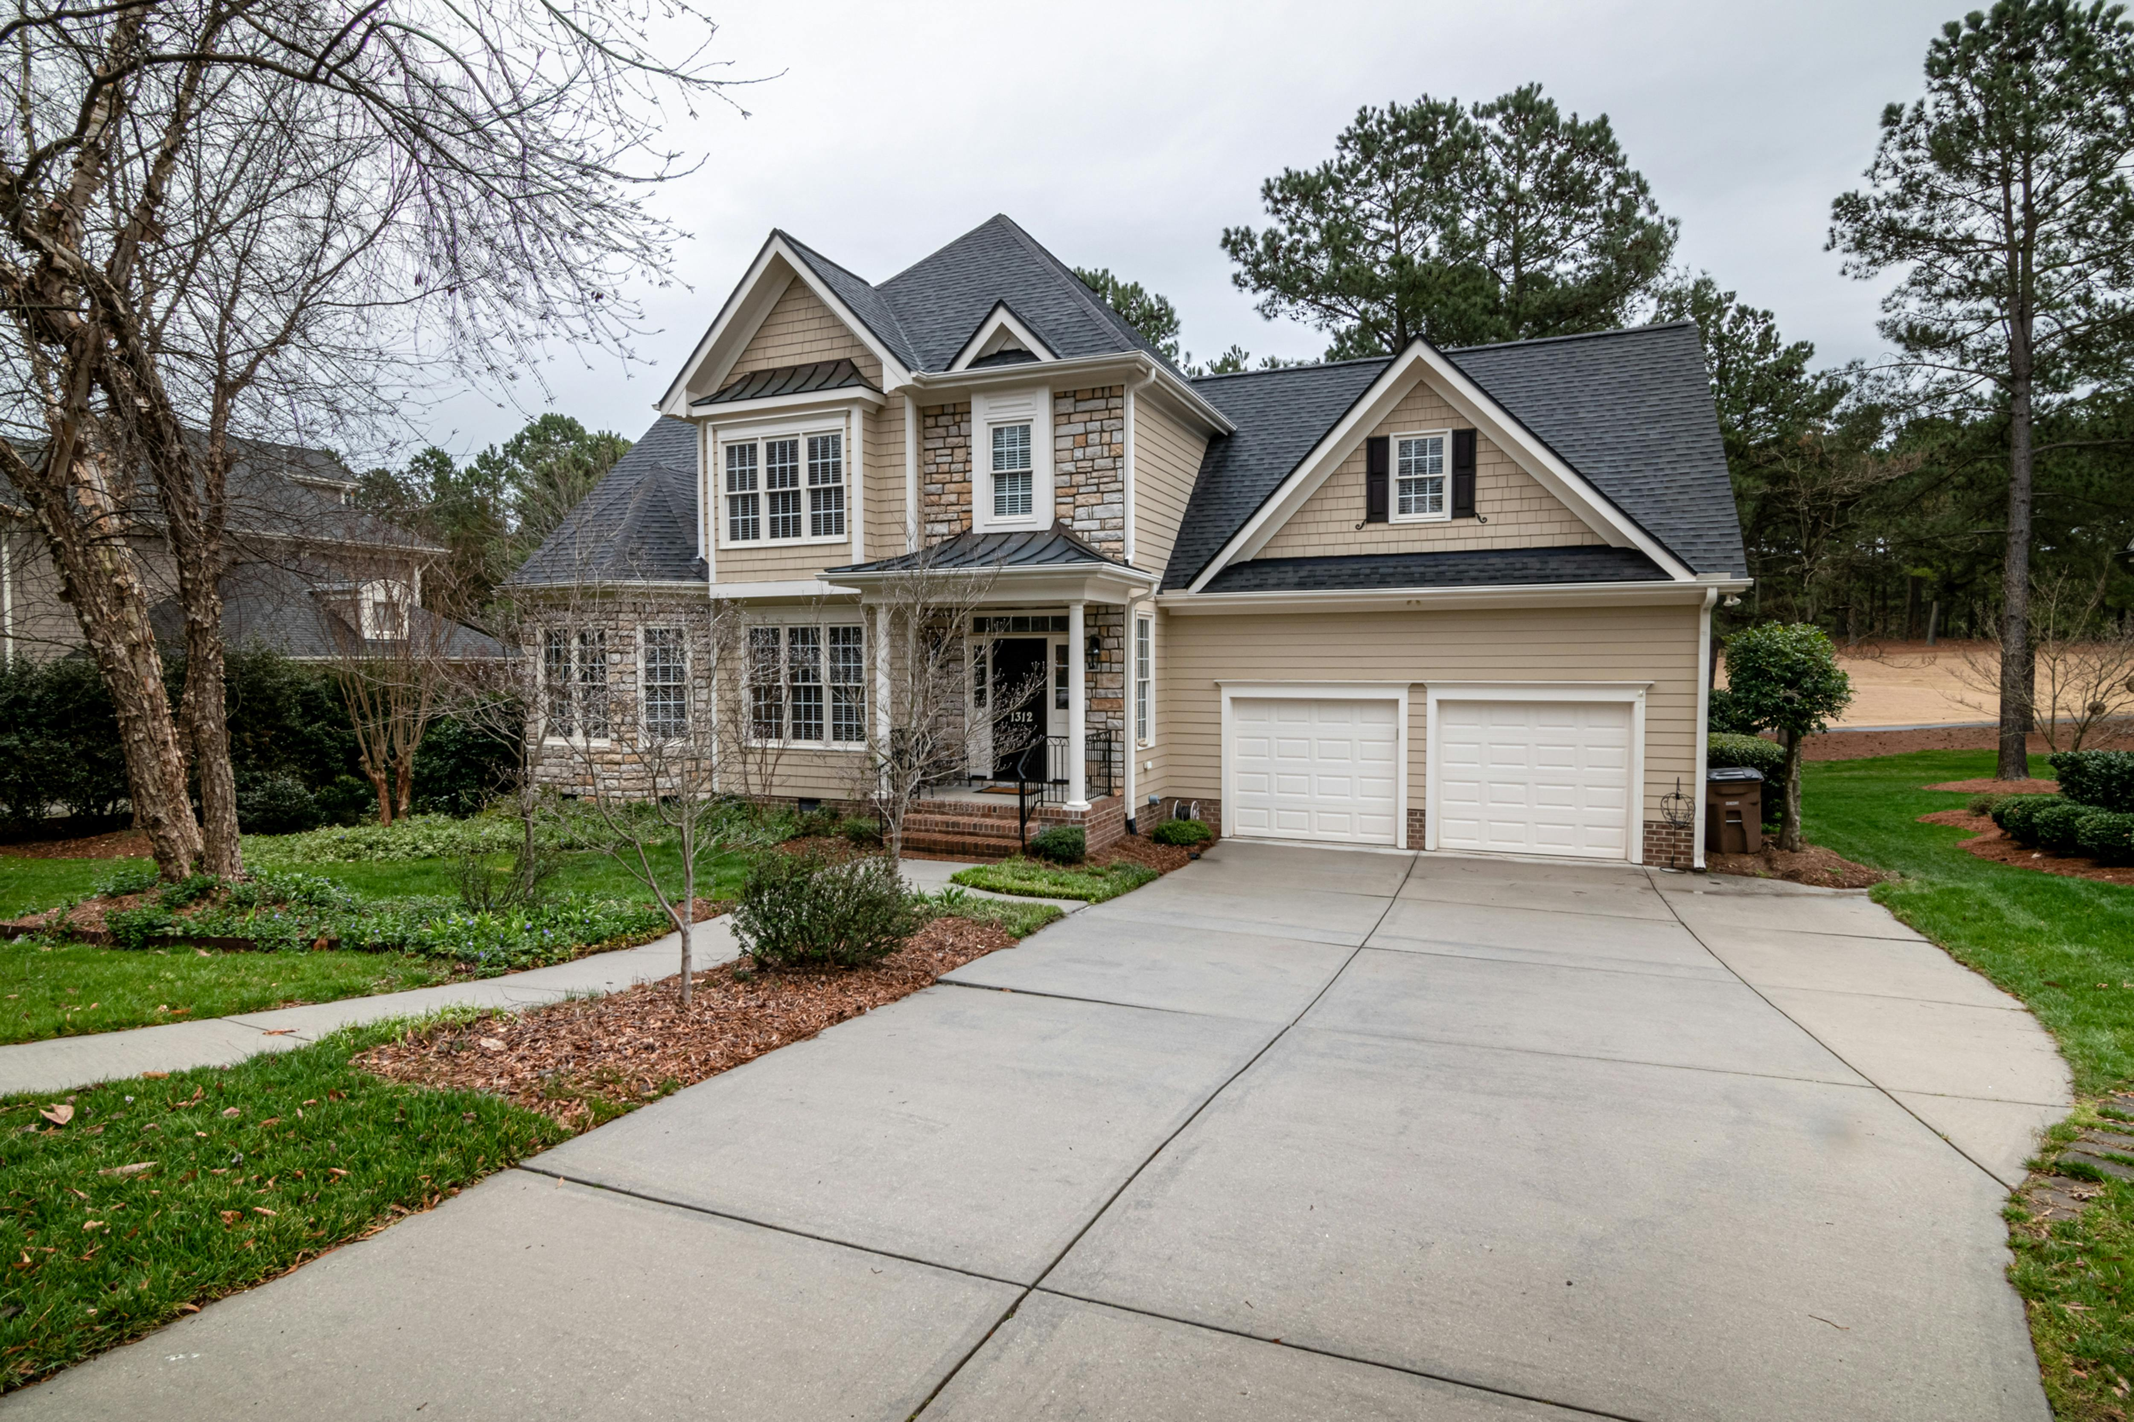
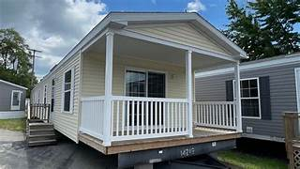

NASHVILLE HOUSING PROJECT
SQL

Slide 2
AIMS AND OBJECTIVES
1.
To analyse the real estate business of the Nashville region across the years 2013-2016.
2.
Analyse trends impacting demand and supply including socio-political and economic.
3.
Spatial /landuse/ acrage/ cost / time-series analysis.
4.
Suggesting strategy to prevent extreme losses in similar situation and bank upon opportunities.

Slide 3
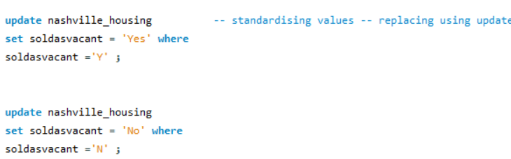
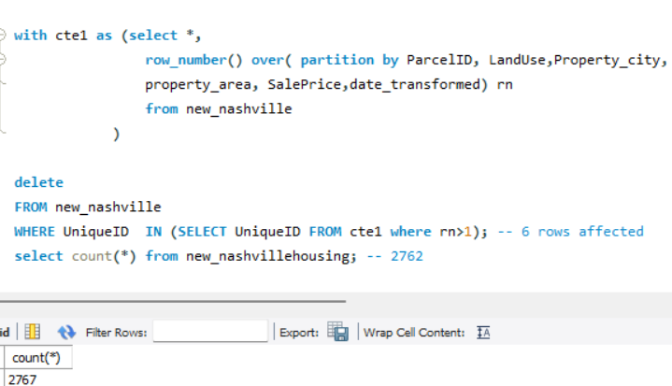
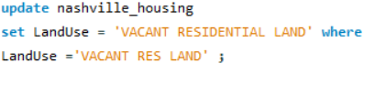
DATA CLEANING AND TRANSFORMATION
1. Checking the null values and empty values from each column using IS NULL OR “ ” with the where clause
2., distinct values in each column to ensure closely situated values are treated as same . Eg the sold as vacant column
3. Checking the data type and strategizing transformation eg. the date, property address, acreage, land value , building value columns
Checking duplicates

Slide 4
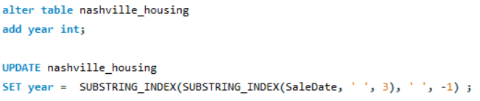
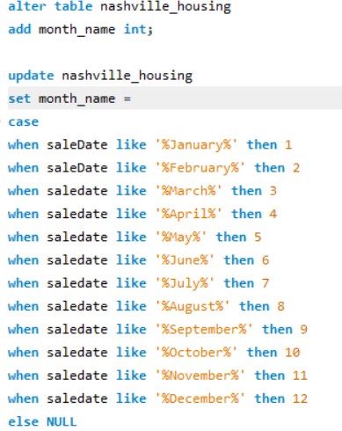
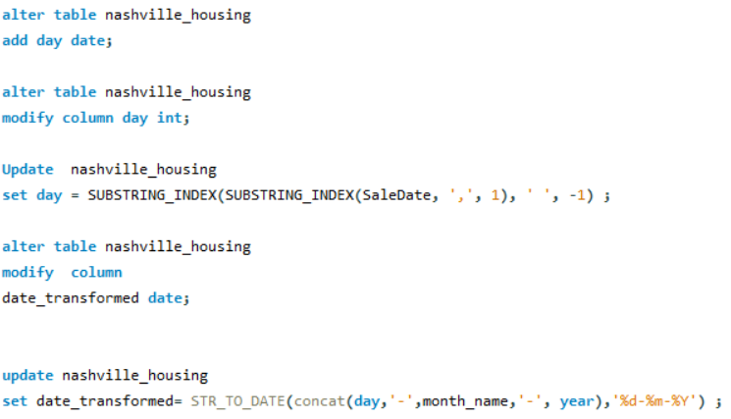
THE SALES DATE COLUMN
FEATURE SPLITTING –
PRIMARY STRATEGIES – STRING MANIPULATION, CASE STATEMENTS
MODUS OPERANDI- adding column (Alter command)
updating ( update )

Slide 5
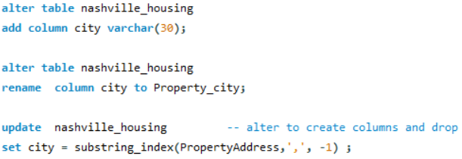
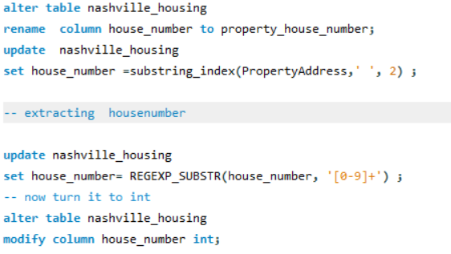
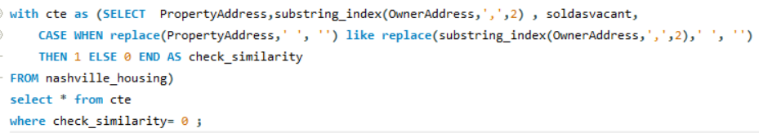
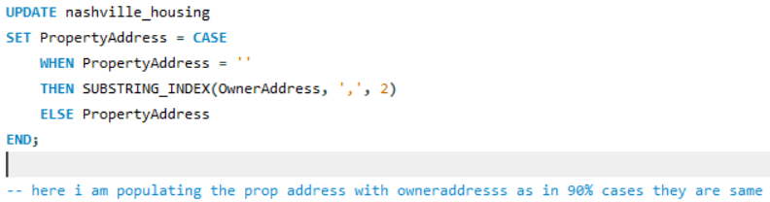
THE PROPERTY ADDRESS COLUMN
FEATURE SPLITTING –
STRING MANIPULATIONS -substring_index, REGEXP_SUBSTR and a combination of these two.
No substring function as length varied and substring index worked well with delimiter more easily (My learnings).
Extracted – City, Area, and House number from the Property address
City- using negative indexing.
Extracting house number – combined functions as only substring
gave number plus text in some rows so regexp substring.
Area / Region –
select regexp_substr(substring_index(PropertyAddress,' ', 3),
'[A-Za-z]+')from nashville_housing as a;
The above concept – extracted substring and then alphabets from that
Comparing the Property address and owner address
The code involves much trimming and replacing white
spaces as as similarity check was failing without it despite
Most important information as same.
This code gave me 18 rows out of 2500+ which has prop add diff from owner address and that too with very slight differences probably due to faulty data
Hence I populated many empty property addresses with owners addresses.

Slide 6
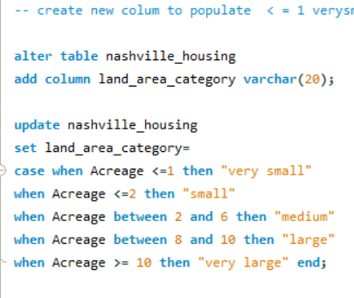
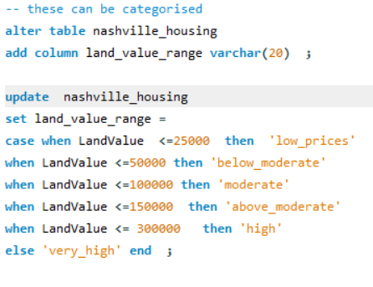
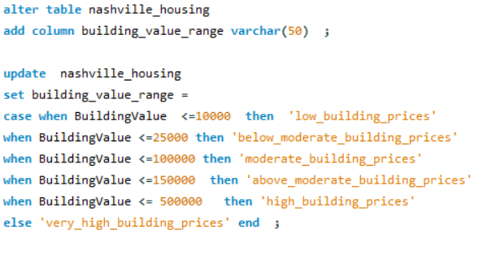
THE ACAREAGE / LAND VALUE COLUMN – BINNING STRATEGY
1.
Acreage COLUMN –
2.
LAND VALUE COLUMN-
3.
The Building Value column –
197 distinct values max is only 47.5 and 12.87 rest are below 10
between 8 and 10 it id 2, >10 is 2 , bw 6 and 8 is 1 bw 4 and 6 is 6; bw 2,4 is 36 ; less than = 2 is 2730
avg land value is 27,519.1832 M with varying ranges
avg building value is 102,897.4757 ,
Max= 450,000 M
Min = 3,000 M
min = 4,000
max= 1,249,900

Slide 7
UNDERSTANDING THE COLUMNS AND THE DOMAIN – LANDUSE/
SINGLE FAMILY USE – Full-blown apartments, spacious
Duplex , quad plex , triplex-
A duplex is a residential building that is divided into two separate units, each with its own entrance, living space, kitchen, and bathroom. The two units can be side by side or stacked one on top of the other.
urban and suburban areas of Nashville as they provide more density than a single-family home while still maintaining a residential feel.
Triplex -higher density housing is being introduced.
Quadplexes are prevalent in areas where there is a demand for affordable multi-family housing, offering a good balance between density and residential quality of life.
A zero-lot-line house is a piece of residential real estate in which the structure comes up to, or very near to, the edge of the property line. Rowhouses, garden homes, patio homes, and townhomes are all types of properties that may be zero-lot-line homes
Office buildings one or two stories – public buildings
Church or parsonage – public gathering spaces
Green belt/res green belt – near eco-friendly zones so probably more expensive
Club/ Union hall/lodge
A split-level home is a type of house where the floor levels are staggered. Typically, these homes have three or more levels that are connected by short flights of stairs. The design is characterized by its efficient use of space and distinct separation of living areas.

Slide 8
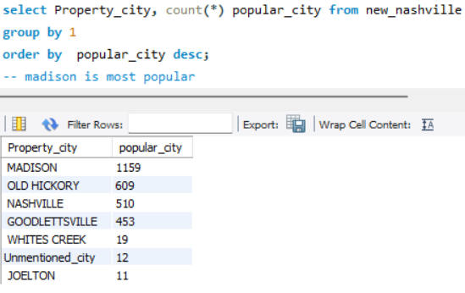
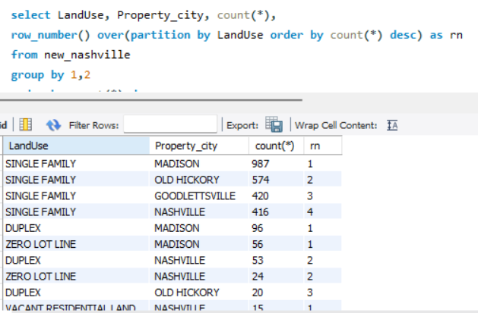
Spatial analysis using city, Landuse
CITY ANALYSIS -
Madison, Hickory, and Goodlettsville are closer to the green ambient zones and connected to Nashville
Observation – all are in proximity of the city but a little in the green zones
Old hickory is near Cumberland river
Joleton and Whitescreek are through in the green region but disconnected.
CITY VS LANDUSE PATTERN –
Top customers based on land use –
single family> duplex > zero lot line
In the middle we have mostly common buildings
However in the end we have clubs/union hall>mobile homes > split class
Insights – here we can target the families by continuing the policies in the cities which they prefer
however clubs and mobile homes offer promising economic growth due to their activities and flexibility.
It must be seen why they are not preferred
Withing the duplex, triplex and quadplex we see that duplex in madison are preferred over
triplex in old hickory however quad plex in OH are preferred over MAD due to space
Vacant resid land is more available in Nashville which can be used for new projects as its
location is similar to MAD and OH
RECOMMENDATION
Since club union halls are preferred in Madison which is a popular residential area more can
be initiated in Nashville and GoodsVille as there the number is less.
Also mobile homes just have Madison where they can be promoted more for their flexibility
Or in areas like Joleton and white creek
Split class house type can be promoted in green areas like Joleton and Whites Creek
The design maximizes the use of a smaller footprint by stacking the living areas.
Often more affordable to build on sloped or uneven terrain compared to levelling land
for a single-story home.

Slide 9
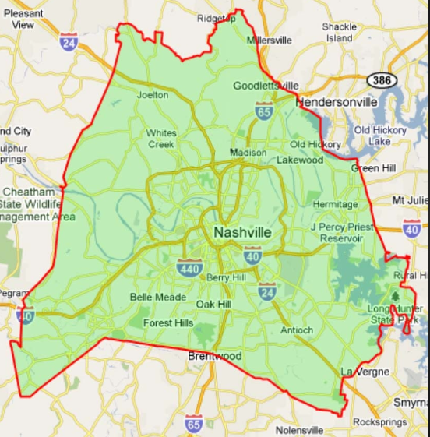
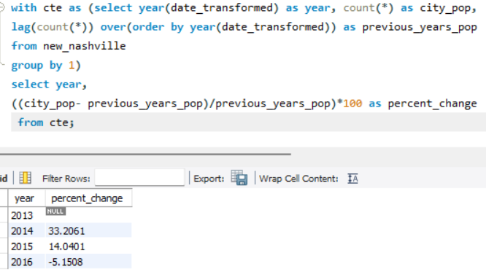
Time series demand analysis
there has been an upward trend from 2013 to 2015 and then descending.
33% jump from 2013 to 2014
Economic recovery after the 2008 financial crisis, lower interest rates by fedral reserve to boost infra policies, and an influx of new residents moving to Nashville due to job opportunities and a growing economy.
Adopted in 2015, the NashvilleNext plan- sustainable and inclusive urban planning. Implied and increase in duplexes, triplexes, and quadplexes to accommodate the growing population.
and then , and reduction in increase in 2015 with 14 %
Federal Reserve Rate Increases (2015-2016)
The 14% increase in 2015, while still positive, indicates a slowdown in the rate of growth. This could be due to market stabilization after the rapid growth in the previous year or early signs of market saturation as supply began to catch up with demand.
followed by a negative trend in 2016.
regulations surrounding short-term rentals (like Airbnb) came up.
Factors could include an oversupply of housing, rising interest rates, or economic uncertainties
A decrease in demand would likely lead to a surplus of unsold or unrented units, reducing profitability. Real estate companies might have faced challenges like price reductions, lower rental yields, or even holding unsold inventory.
Inights for the business that decrease in trend should have been a priority of the stakeholders to escape from bigger losses
This could involve slowing down new construction, focusing on selling or renting existing units, and possibly diversifying their portfolio to include more resilient investments.

Slide 10
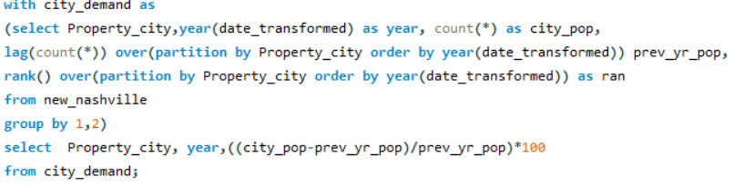
TIME SERIES SPATIAL/LANDUSE ANALYSIS
MADISON / Nashville – it follows a similar overall trend in the previous slide with the increase being more significant in 2014> 2015 and negative in 2016
Suggesting boom-bust cycle- balancing new construction with actual market demand and avoiding overbuilding.
Goodletville demand has been in constant decline due to a sudden jump in the first year.
The initial demand spike likely led to oversupply, causing a decline
Old hickory has steadily increased from 2013-2015 and is stable in 2016.
So probably strategies of demand and supply formed here vs in Goodlettsville can be implemented elsewhere.
Coming to less popular cities-
Joleton – a very stark observation that a sudden 200% jump from negative demand in 2014 with a stable 33% in 2016
Similar case with unmentioned_city with a 200% followed by a 133% inc in demand
These are probably due to the saturation in other regions like madison and old hickory
In terms of public buildings, churches, community hall no change in demand
Single housing – follows the broad yearly trend of high increase30%,15% and then slow followed by a negative trend in 2016
Similar trends in zero- lot line which saw a much higher -92% rise in demand in 2014 followed by 11% inc and 6% dec
In duplexes a negative trend after a sudden increase however we see a positive change in demand during the 2016 period which is 35.7 probably due to a rise in prices of single story or saturation and also the incoming workforce which needed more affordable hosuing. (4)
Similar trend in triplex where 100% inc in demand can be seen for 2016.
So probably it must be noted what factors lead to rise in such demand and thus supply strategies must be made for these segments to keep profits intact

Slide 11
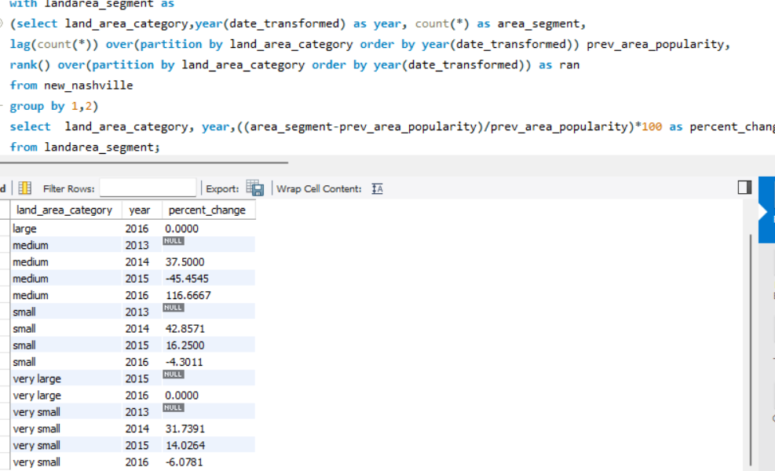
LAND AREA CATEGORY AND TRENDS
OVERALL TREND - very small > small > medium
Very small category is most popular in madison > old hickory and Nashville
Thus following the overall trend
Prefered by single family> duplex >zero lot line
Also most common public buildings are here
In small land madison followed by Goodlettsville thus surpassing old Hickroy
Single family > duplex> vacant res land
These residential lands can be used for construction
Madison’s very small_lands are mostly available which implies prices are reasonable for single families -- foll by this for vary small cat old hickory > Nashville and > Goodlettsville are most preferred
Similar trends in medium
Large and very large are in Whites Creek and old Hickory region
The change in demand –
We see that the very small and small category areas follow the overall trend in demand where a sudden increase followed by a stable inc in 2014 and a negative demand in 2016
However for medium-range homes the trend is 35 % followed by a dec of 45% and then a considerable inc of 116%
Might be due to saturation in the very small and small category or due to reduction of prices considering previous years decline
However both are problematic as first case is spill over effect which might stop is supply increases in those category
Second case means the property value and profit is being compromised

Slide 12
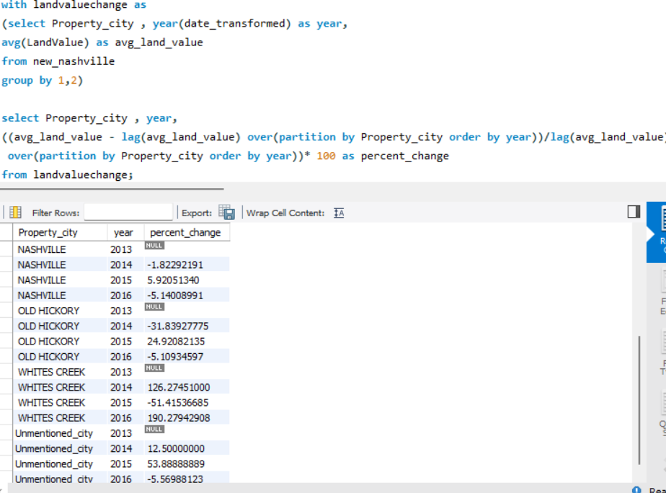
Land value / building value Analysis
In madison which is the most popular city we see the average price fell by 3.9% in 2014 followed by a 2.6% rise in 2015 and -3.7% dec in 2016
Average land value in old Hickory fell by 31% in 2014 with a 24% inc in 2015 and again a 5% decrease in 2016
Similar trend in Nashville but the amount was less
In less popular regions of Joleton there has been no change in prices
Whites Creek has seen a drastic 126% inc in 2014 followed by 51% dec and 191% inc

Slide 13
RECOMMENDATIONS
OBSERVING THE TREND -
There has been a shift in demand to the Joleton and Whitescreek and the unmentioned city section which must be banked upon
However the over-construction must be avoided which may have led to saturation in the Madison region
There is also a shift in demand for the duplex and triplex which can be a focus for stakeholders as it also promises more income with more residents – along with the scope of offices clubs and other public buildings
The triplex and quadplex are preferred in the medium category and we also see a rise in medium-area homes which may propel profits
From the socio-political perspective
The boom-bust cycle must be kept in sight while taking projects and accordingly balanced and sustainable developments must be undertaken
From the perspective of innovative housing mobile homes and split homes which are smaller in size and in present time must be in demand due to the change in inhybrid and remote work can be rethought
This will be beneficial as if the restraint in rental regulations on houses like air bnb might have led to less growth such cultural change might be banked upon by the business owners

